Slide 1

Red-Store
Preritha Gangadhar
Dhanalakshmi Kondur
Prajwal Angadi
Venkatateja C
Aishwarya Prakash
Under the guidance of:
Sriram

Slide 2
Introduction
An eCommerce website is an information technology method in which traders, businesses/distributors/marketers can sell
The customer can purchase on that website electronically by using the internet on the mobile and computer.
It means an e-commerce website is an online shop. e means electronic. Commerce means business.

Slide 3
Problem Statement
E-commerce provides an easy way to sell products to a large customer base. However, there is a lot of competition among multiple e-commerce sites.
When users land on an e-commerce site, they expect to find what they are looking for quickly and easily. Also, users are not sure about the brands or the actual products they want to purchase.
They have a very broad idea about what they want to buy. Many customers nowadays search for their products on Google rather than visiting specific e-commerce sites. They believe that Google will take them to the e-commerce sites that have their product.

Slide 4
Requirements:
1. AWS(Amazon web services)
EC2 instances
Virtual Machine(Xampp Server)
2. Visual Studio Code
Html code
Php code
3. Browser(http/https)

Slide 5
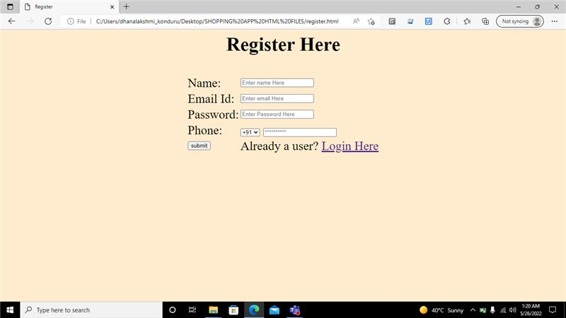
Registration Page

Slide 6
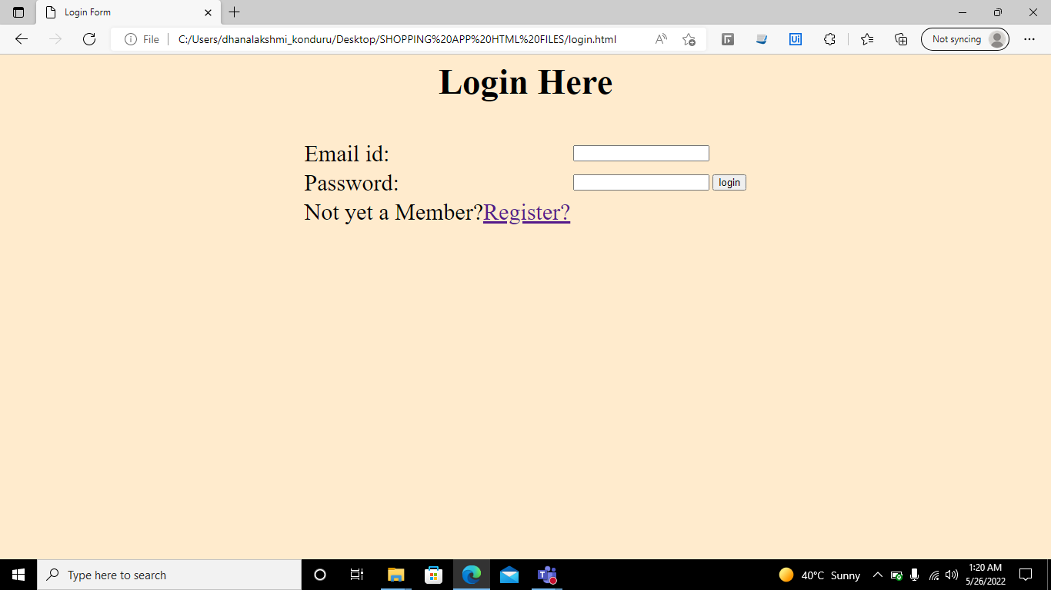
Login Page

Slide 7
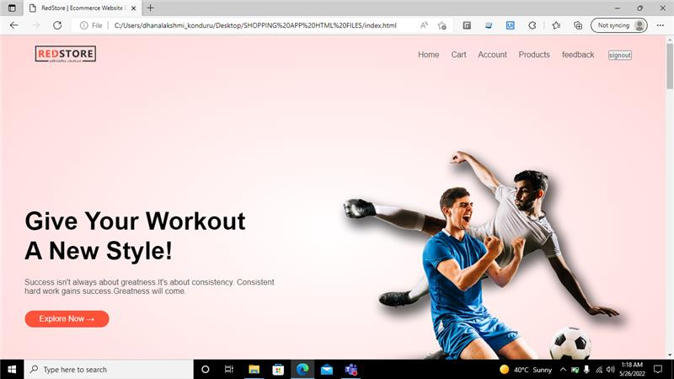
Home page

Slide 8
THANK YOU

